Slide 1


ALGORITHM FOR SAFETY AND DISTANCE OPTIMIZATION ON ROUTES IN MEDELLÍN

Slide 2
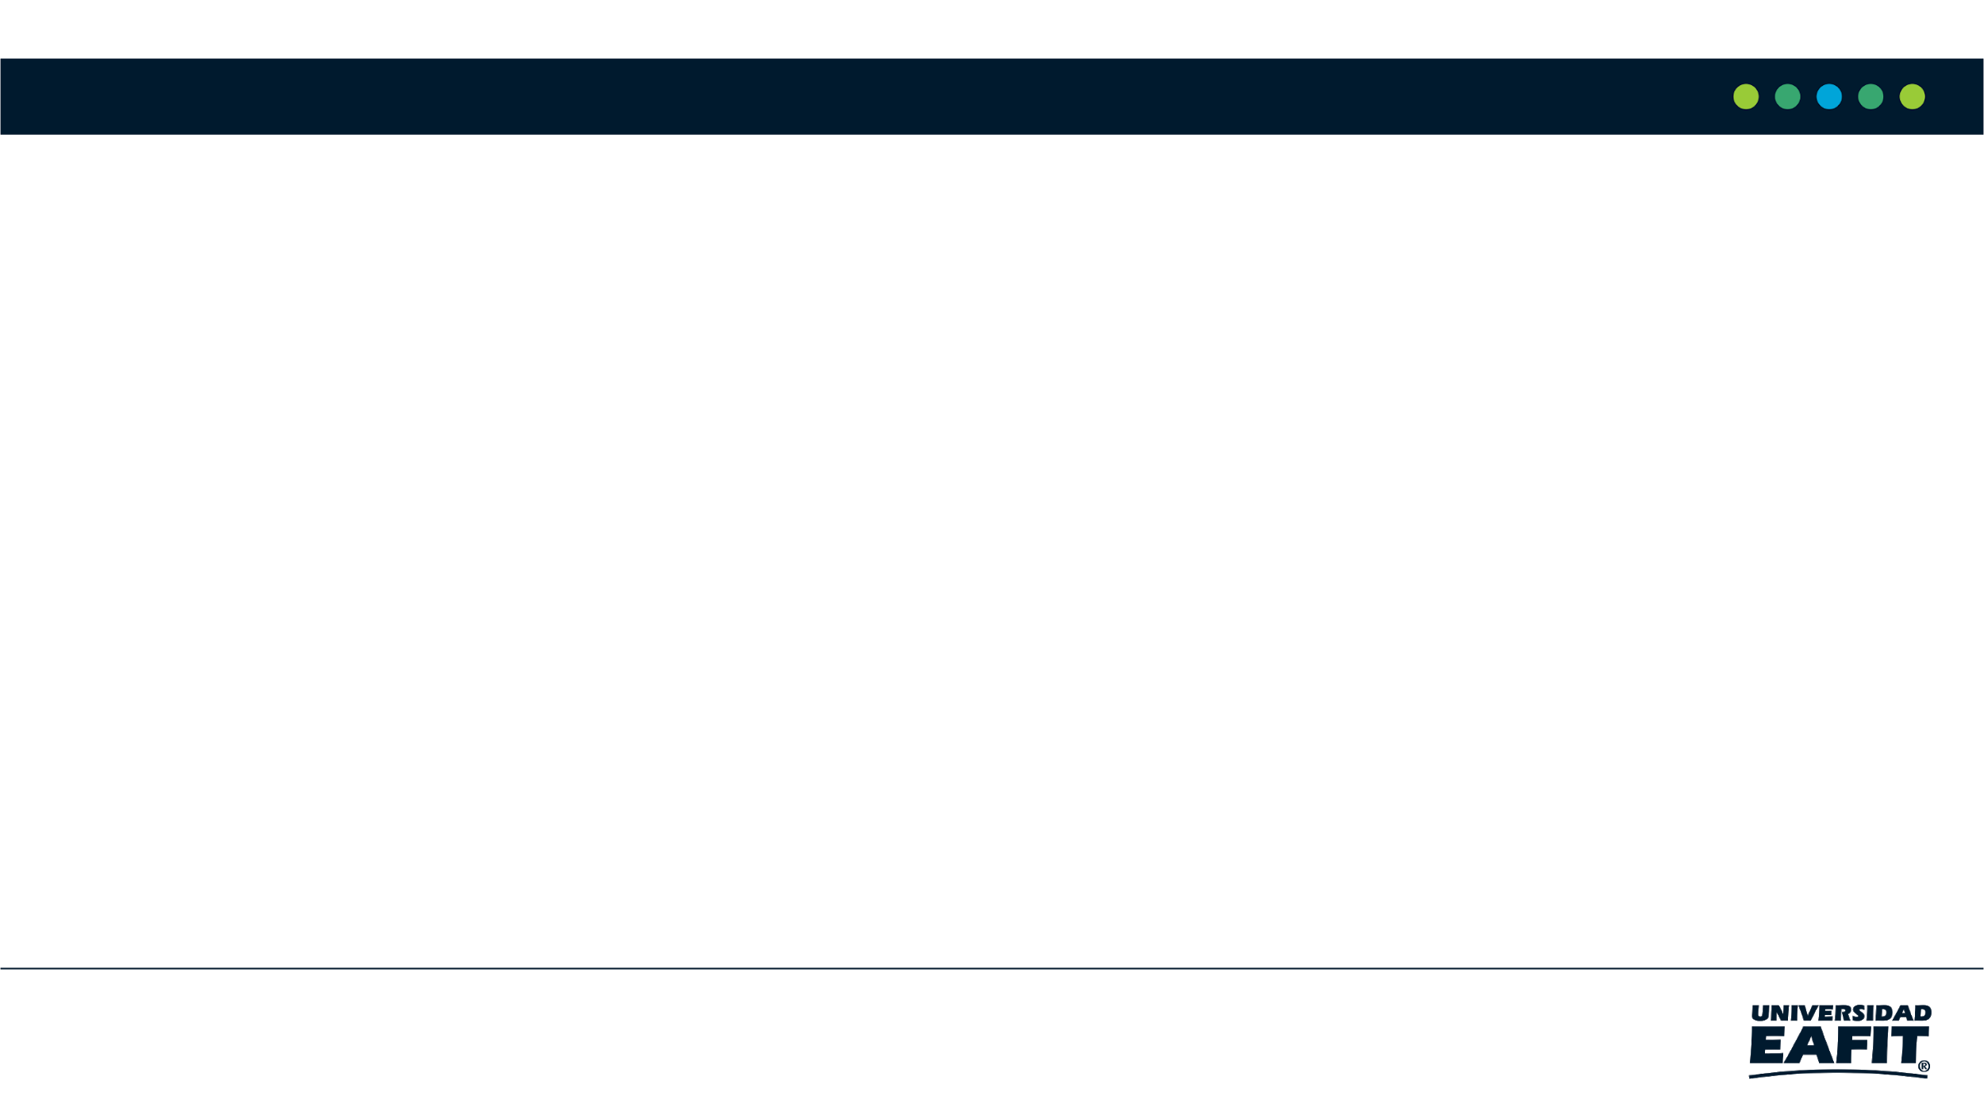
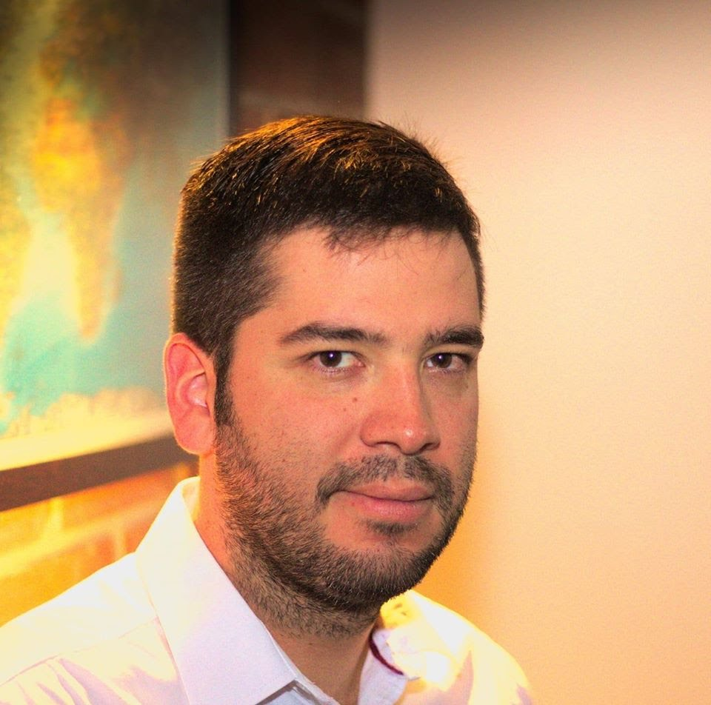
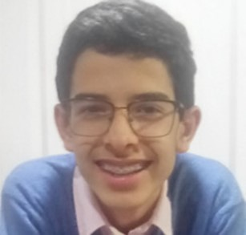
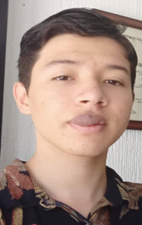
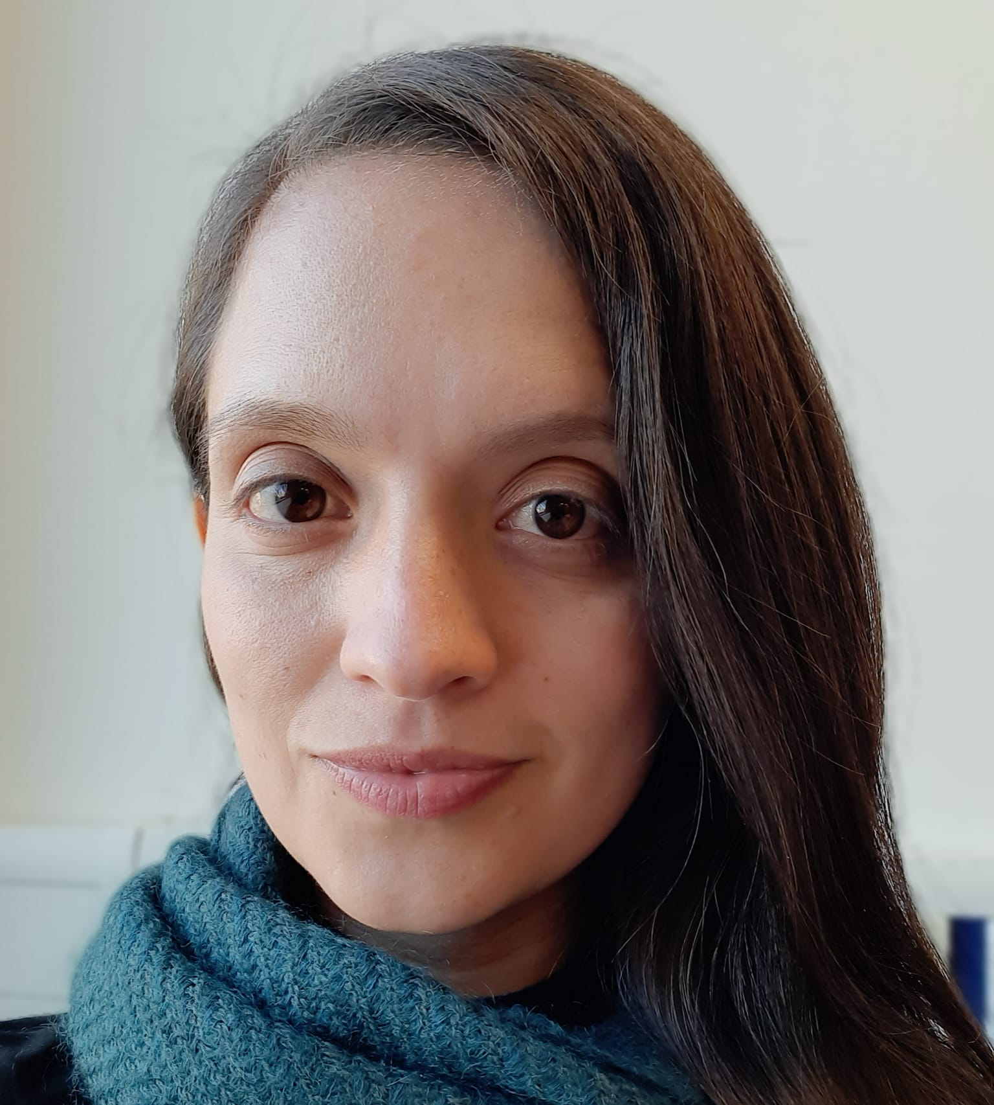

Presentation of the team
Sharif Velásquez
Algorithms Researcher
Andrés Parra
Articles Review
Andrea Serna
Literature Review
Mauricio Toro
Data Preparation
https://github.com/SharifVelasquezAlzate/SafetyAndDistanceOptimization

